Slide 1
Welcome Everyone

Slide 2

EVENTEASE
An Innovative Offline Calendar Events Solution
Presented By: Rohan Rashid et al.
Student ID: 21222203050
Course: CSE 328
Intake: 41-1 (DH)
Date: 09-12-24

Slide 3

BANGLADESH UNIVERSITY OF BUSINESS & TECHNOLOGY (BUBT)
Participants Are: Dept. Of CSE
Name of Students | ID | Intake
Md Imran Hossen | 21222203001 | 41-01
Rajesh Chandra Barman | 21222203002 | 41-01
Istiak Ahmed Arnob | 21222203028 | 41-01
Bikash Chandra Ray | 21222203045 | 41-01
Rohan Rashid | 21222203050 | 41-01
Under Supervision of:
Md. Mahbubur Rahman
Assistant Professor,
Department of Computer Science & Engineering, Bangladesh University of Business and Technology (BUBT).

Slide 4
Our Agenda
INTRODUCTION 4
PROBLEM STATEMENT 5
OBJECTIVES 6
TECHNOLOGY STACK 7
SYSTEM ARCHITECTURE 8-13
FUNCTIONAL FEATURES 14
SYSTEM DESIGN 15-17
OBSERVATIONS AND LIMITATIONS 18
FUTURE ENHANCEMENT 19
CONCLUSION 20
REFERENCES 21

Slide 5

Introduction
What is Eventease?
  An Android-based offline calendar app to manage events efficiently without internet access..
Purpose of the Project:
  Provide a seamless and efficient platform for scheduling and managing events with complete offline functionality..

Slide 6
Problem Statement
Challenges with Traditional Systems:
  Dependence on internet connectivity for event management..
  Lack of offline functionality in most calendar apps..
  Lack of accessibility on Online.
Need for Automation:
  Eventease enables users to add, edit, search, and manage events offline seamlessly..

Slide 7
Objectives
Primary Goals:
  Develop a fully offline calendar app with CRUD operations for events..
  Provide features for event searching, editing, and marking as completed
  Ensure a smooth and intuitive user experience..

Slide 8
Technology Stack
Frontend:
  Dart programming language on Flutter SDK..
Backend:
  SQfLite
Database:
  SQFlite database for offline data storage.
Development Environment:
  Visual Studio Code.

Slide 9
System Architecture
Overview of Features:
  Callender: Showing a Callender with the date of today.
  Add Event: Create events with a start and end time.
  Search Event: Search for events by name or date.
  Edit Event: Modify event details.
  Delete Event: Remove events when needed.
  Mark as Completed: Track event completion status.

Slide 10
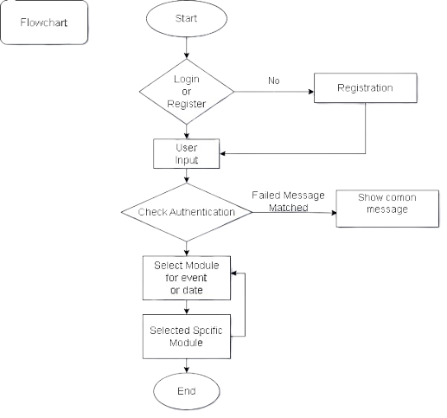
System Architecture
FLOW CHART: :Showing a activity diagram of how data flows between modules.

Slide 11
Functional Features
Event Management:
  Add, edit, search, delete, and mark events as completed.
Offline Capability:
  Full functionality without requiring internet access.
User-Friendly Interface:
  Designed for intuitive interaction and smooth navigation.

Slide 12
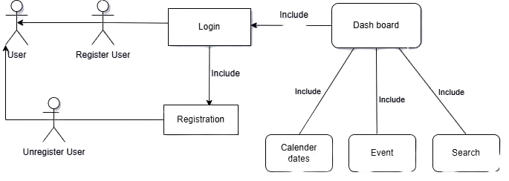
System Design
Use Case Diagram:
  Show interaction between users and the system.

Slide 13
System Design
DFD
External Entities:
  User: Provides inputs like event creation details, search parameters, or event updates.
Processes:
  Event Management: Handles the addition, editing, and deletion of events.
  Event Search: Handles searching and retrieving events based on user input (e.g., date or name).
  Event Status Update: Manages marking events as completed.
Data Stores:
  Event Database (SQFlite): Stores all event data.
  Completed Events: Tracks the status of events that are marked as completed.
Flow:
  User interacts with the system by adding, searching, and editing events.
  Event Management retrieves and stores data to/from the Event Database for event creation, editing, and deletion.
  Event Search retrieves event data based on search parameters from the Event Database.
  Event Status Update updates the status of events in the Event Database.

Slide 14
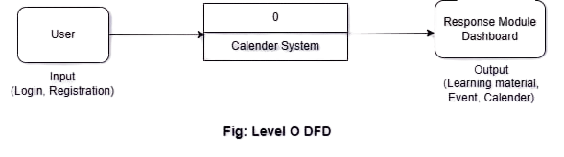
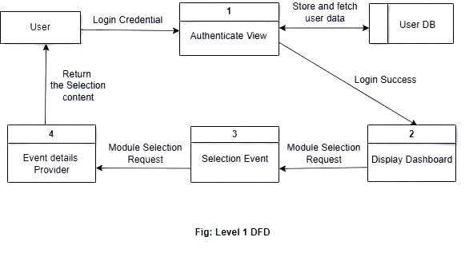
System Design
level 0 DFD:
level 1 DFD:

Slide 15
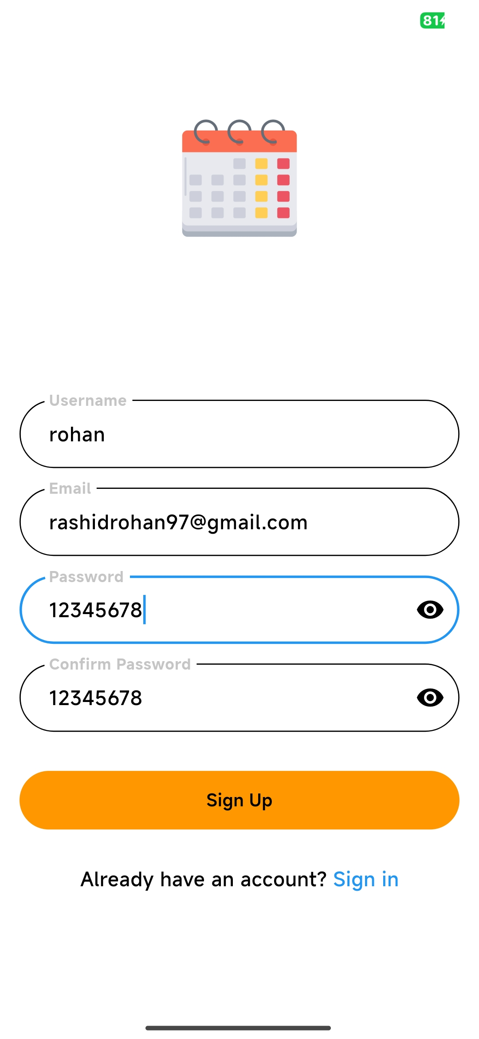
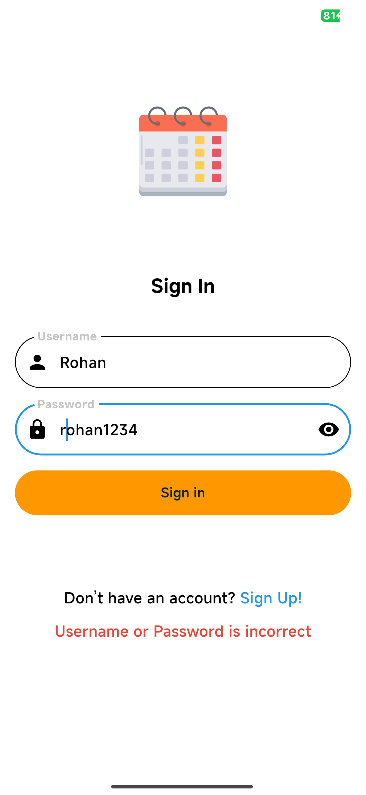
Implementation Details
User Interface Screenshots:
  Sign Up Page: Create a new account with simple, user-friendly steps..
User Interface Screenshots:
  Sign In Page: Securely log into the app using user credentials.

Slide 16
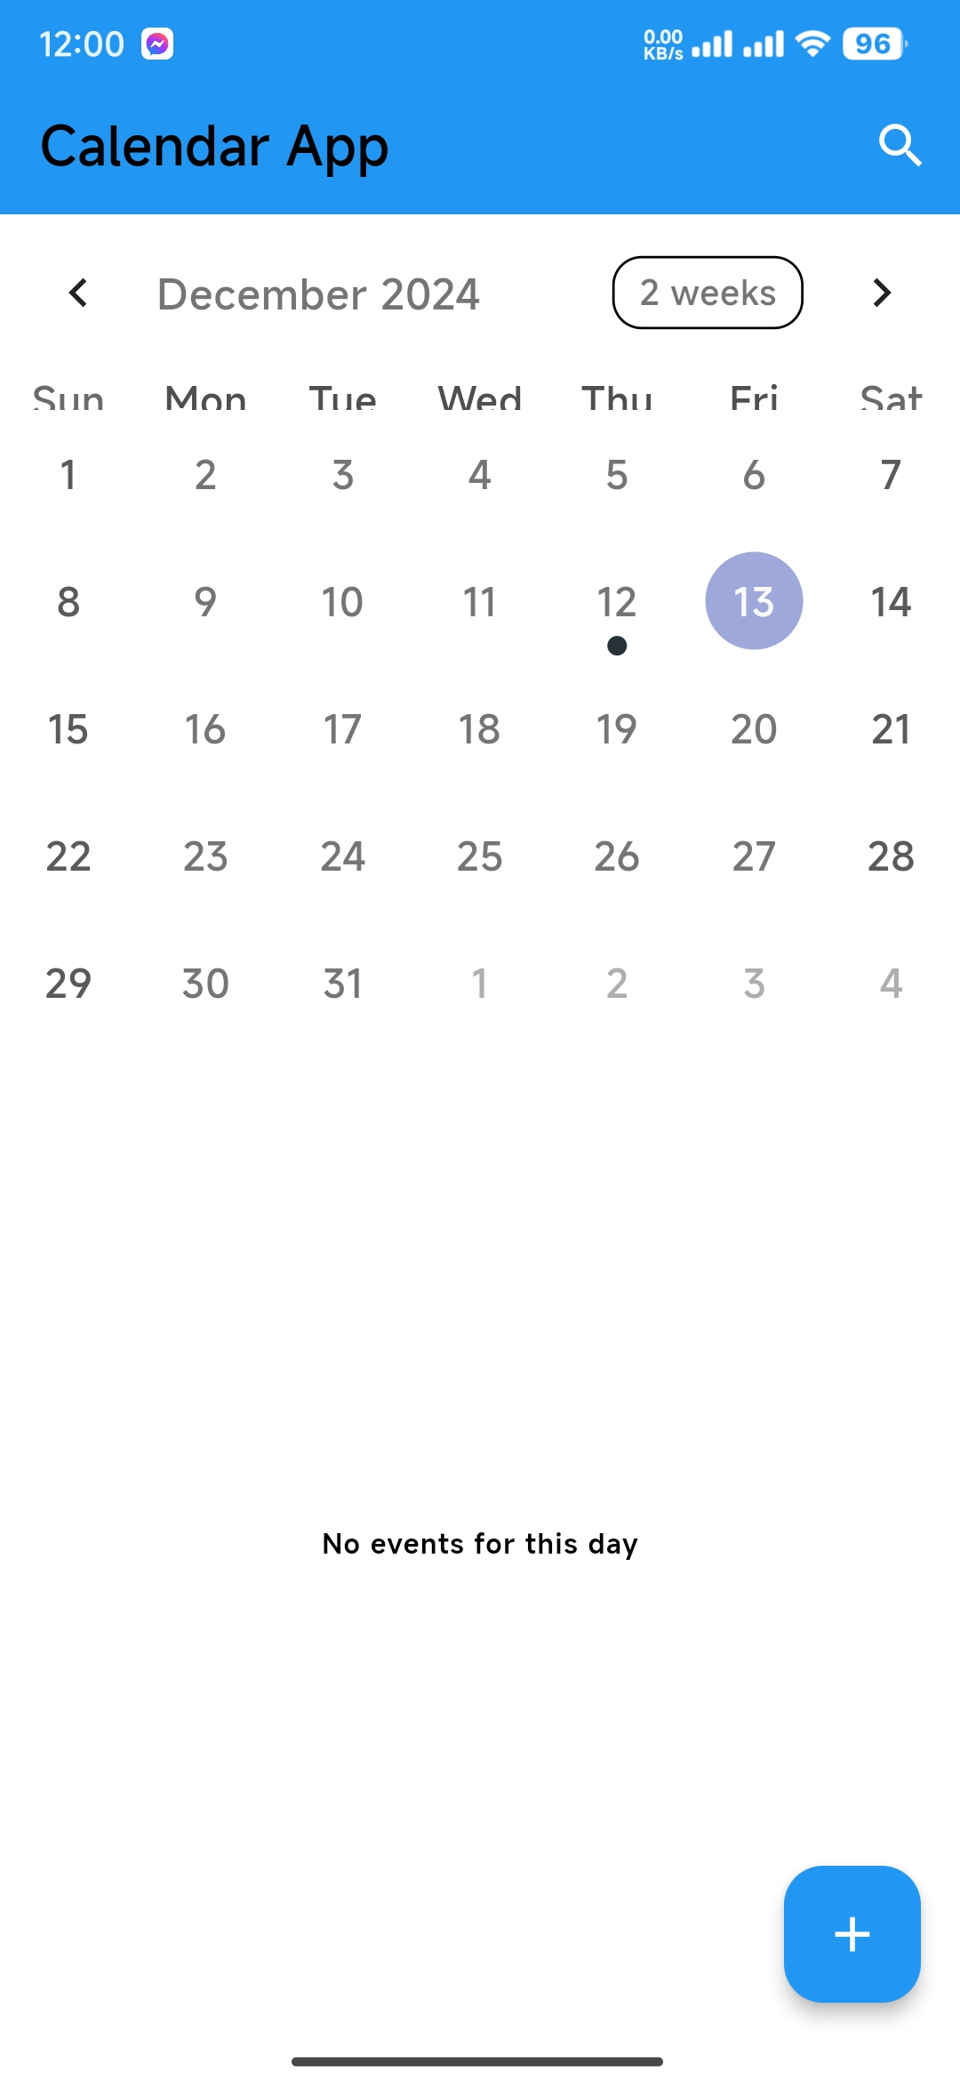
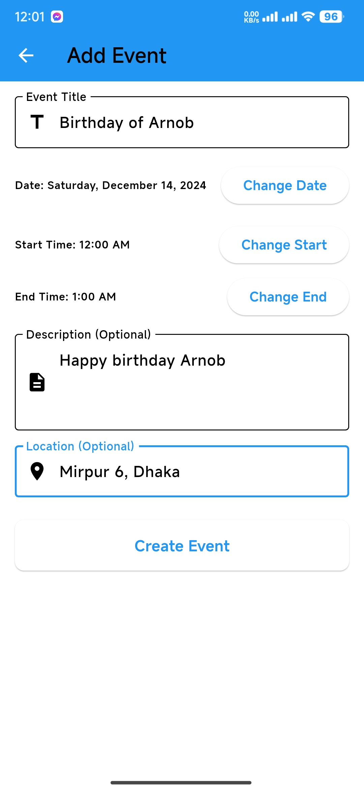
Implementation Details
User Interface Screenshots:
  Dashboard: View an organized summary of all scheduled events.
User Interface Screenshots:
  Add Event Page: Create new events by specifying start and end times.
16

Slide 17
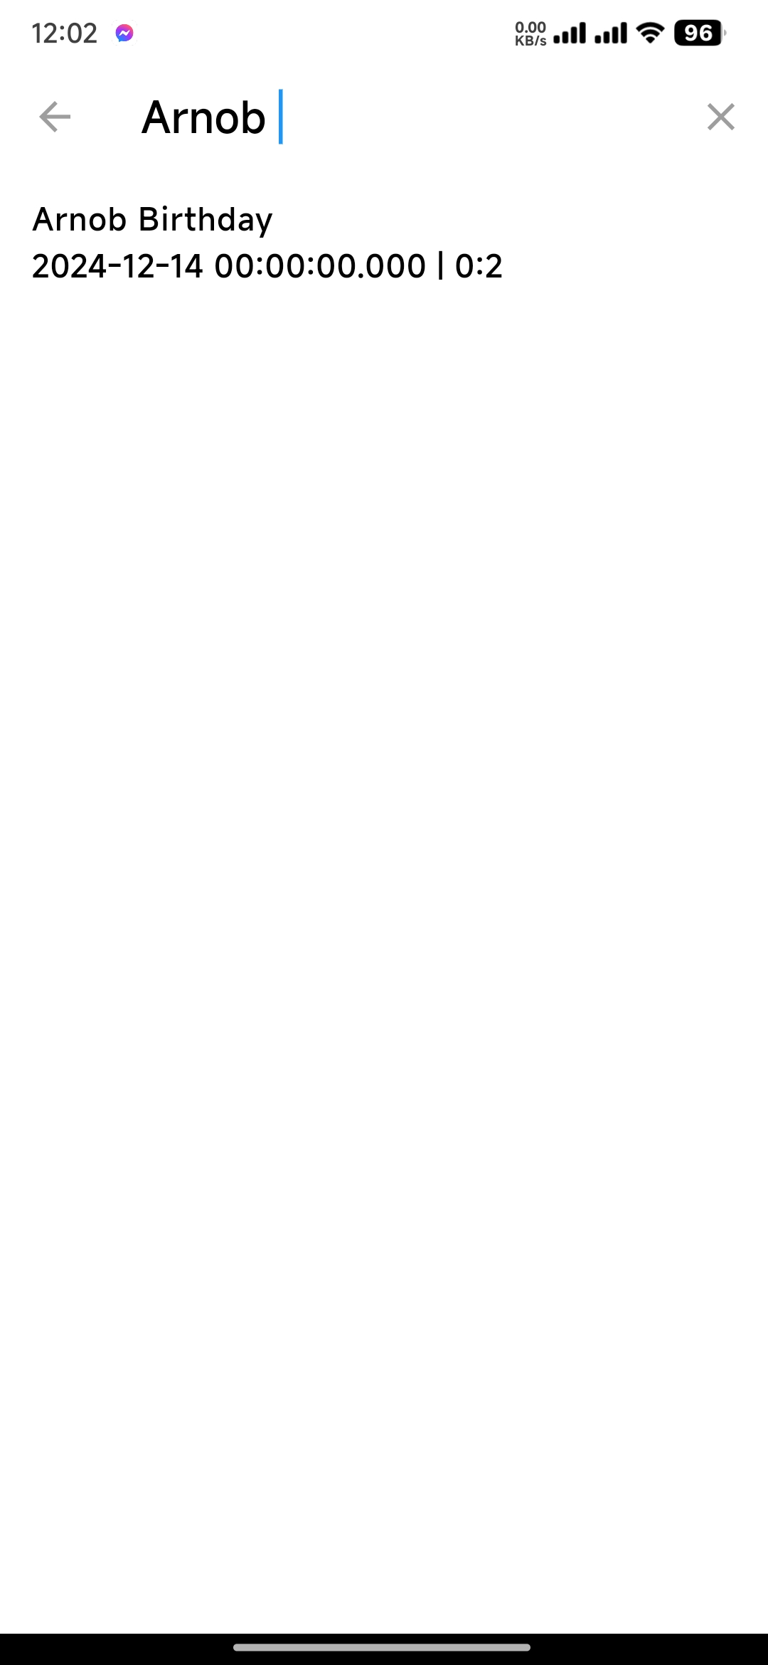
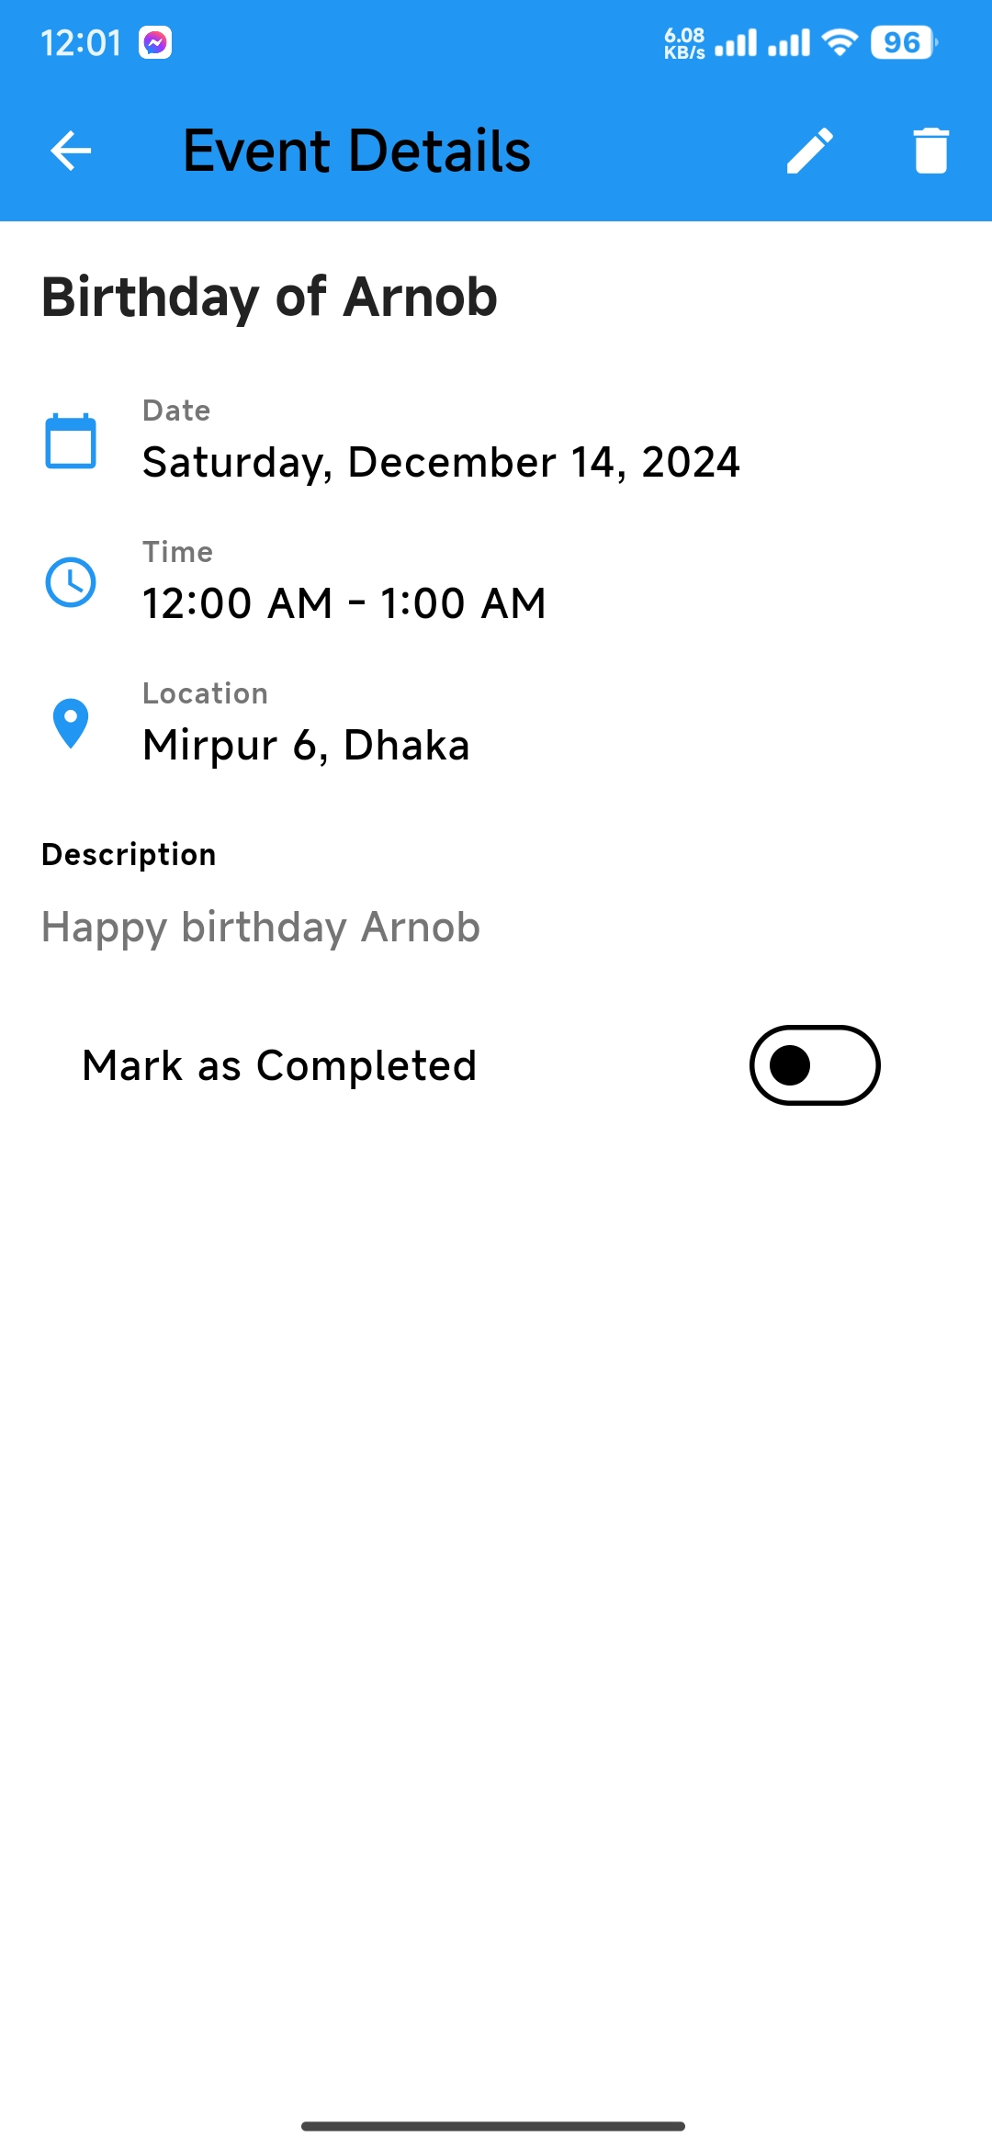
Implementation Details
User Interface Screenshots:
  Search Event Page: Locate events instantly by name or date..
User Interface Screenshots:
  Modify Event Page: Edit the details of an existing event with ease..
17

Slide 18
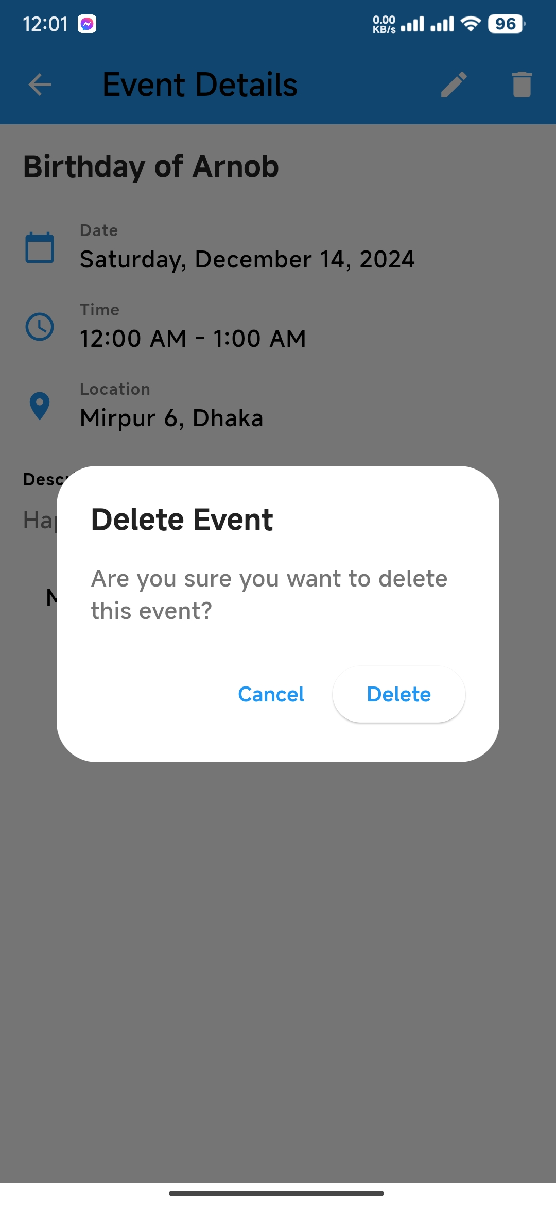
Implementation Details
User Interface Screenshots:
  Delete Event Page: Remove an event permanently from the schedule.
User Interface Screenshots:
  After Deletion: Show Dashboard
18

Slide 19
Observations and Limitations
Observations:
  Smooth and efficient offline event management.
  Minimal resource usage ensuring high performance on low-end devices.
Limitations:
  No cloud-based backup for events.
  Features like recurring events are not included in the current version.

Slide 20
Future Enhancements
Add cloud sync functionality for optional online backup.
Implement recurring event scheduling.
Include reminders and notification alerts for events.

Slide 21
Conclusion
Summary of Findings:
  Eventease is a reliable, user-friendly offline calendar application designed to manage events efficiently without internet connectivity.
  The application successfully provides all essential features such as adding, searching, editing, and deleting events while maintaining high performance.
Key Takeaways:
  Eventease offers a scalable offline solution to meet the growing need for accessible event management.
  Its minimalistic design and offline functionality make it suitable for both personal and professional use.

Slide 22
References
Flutter Documentation:
https://flutter.dev/docs
Dart Programming Language:
https://dart.dev
SQFlite Documentation:
https://pub.dev/packages/sqflite
Visual Studio Code:
https://code.visualstudio.com
Material Design Guidelines:
https://material.io/design

Slide 23


Slide 24
Thank You
👤 Rohan RASHID
📞 01612181539
  📧 21222203050@cse.bubt.edu.bd

